Slide 1
Health Care Hope
Reaching Congregations & Communities
Medicaid Expansion Outreach Overview
Fall 2018

Slide 2
Why The Faith Community Is Called To Help
Our obligation to care for the poor is manifested when we:
Offer hope in the darkness of despair
Bring relief to mounting distress
Extend compassion to the suffering
Ensure inherent dignity of the vulnerable
Build equitable access as a common good
#HealthCareHope
#Medicaidexpansion
#MedicaidAccess
#VAinterfaith

Slide 3
How We Are Going To Reach Them
#HealthCareHope
Awareness Collateral (available on website to download, print and distribute)
Trifold Pamphlet
Congregational Bulletin Inserts
Flyers, Postcards and Window Placards
Social Media Graphics (on our Facebook, Twitter and Instagram accounts to share)
Newsletter Briefs and Infographics
Eblasts and Blog Posting
Organizing Toolkit (available on website to download, print and distribute)
Fact Sheets, Maps, One-Pager Action Items
Public Housing Lists & Contact Info
Partner Resources Links
#HealthCareHope
#Medicaidexpansion
#MedicaidAccess
#VAinterfaith

Slide 4
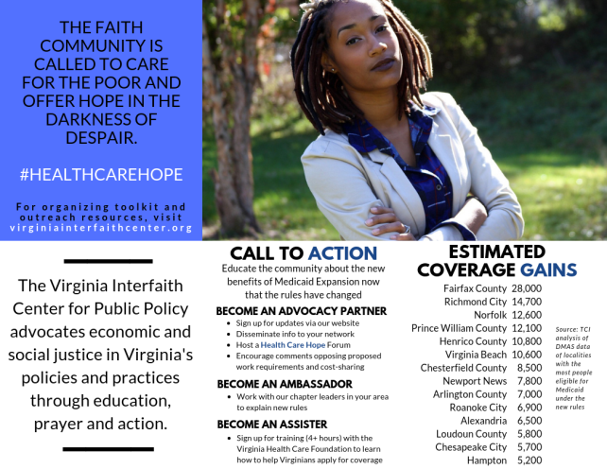
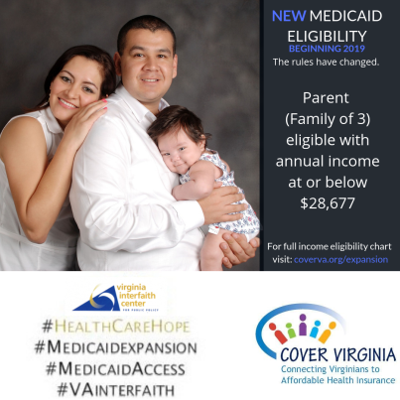
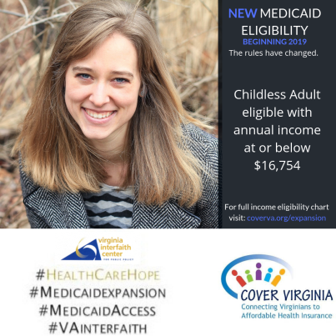
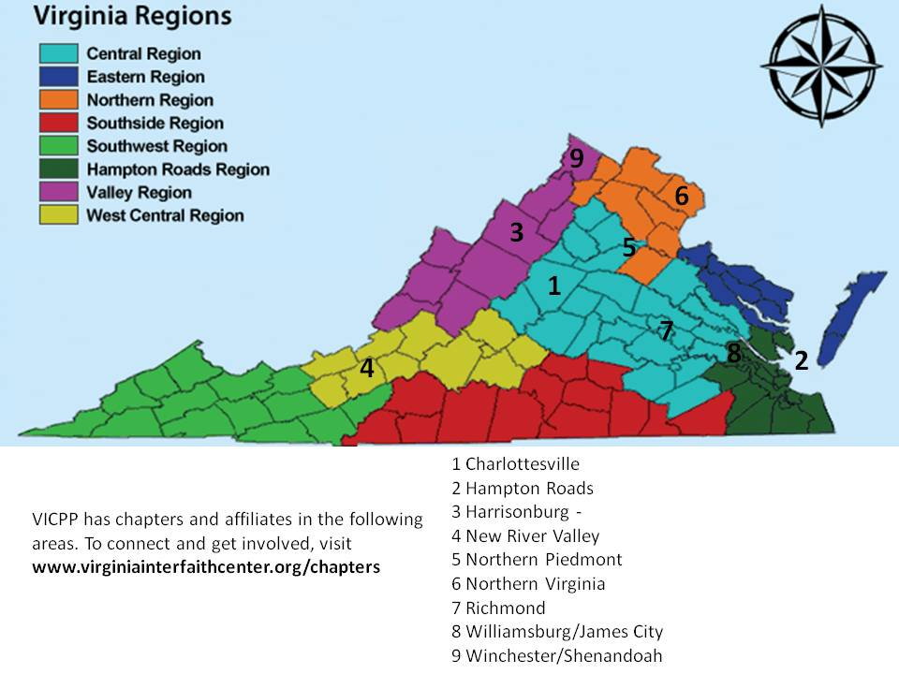
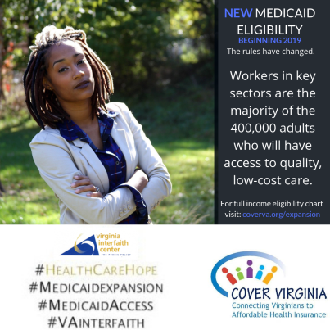
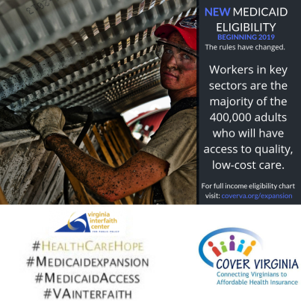
How We Are Going To Reach Them
#HealthCareHope
Core Visuals

Slide 5
How We Are Going To Reach Them
#HealthCareHope
Key Outreach and Organizing Activities
Presentations to Denominational Meetings
Info Dissemination to Congregations, HAV Coalition, Community Partners and Affiliates, Member Associations and Employers in Key Industries, Workforce Centers
Anchoring or Supporting Community Forums
Media Blitz on First Day of Enrollment
Social Media & Video Testimonials
#HealthCareHope
#Medicaidexpansion
#MedicaidAccess
#VAinterfaith

Slide 6
Call to Action and Fact Sheets
Become an
Advocacy Partner: Commit to participate
Sign up for updates
Disseminate info in houses of worship and community
Host a Health Care Hope Forum
Encourage comments opposing proposed regulations on work requirements and cost-sharing
Ambassador: Commit to educate
Work with VICPP chapter leaders to explain new eligibility rules to congregation and community
Assister: Commit to facilitate
Sign up for training (4+ hours) with the Virginia Health Care Foundation to learn how to help people apply
#HealthCareHope
#Medicaidexpansion
#MedicaidAccess
#VAinterfaith

Slide 7
Outreach Priority Target 1
Localities with more than 5,000 uninsured
Fairfax County
Richmond City
Norfolk
Prince William County
Henrico County
Virginia Beach
Chesterfield County
Newport News
Arlington County
Roanoke City
Alexandria
Loudoun County
Chesapeake City
Hampton
28,000
14,700
12,600
12,100
10,800
10,600
8,500
7,800
7,000
6,900
6,500
5,800
5,700
5,200
Source: TCI
Full listing of localities available on their website
#HealthCareHope
#Medicaidexpansion
#MedicaidAccess
#VAinterfaith
142,200

Slide 8
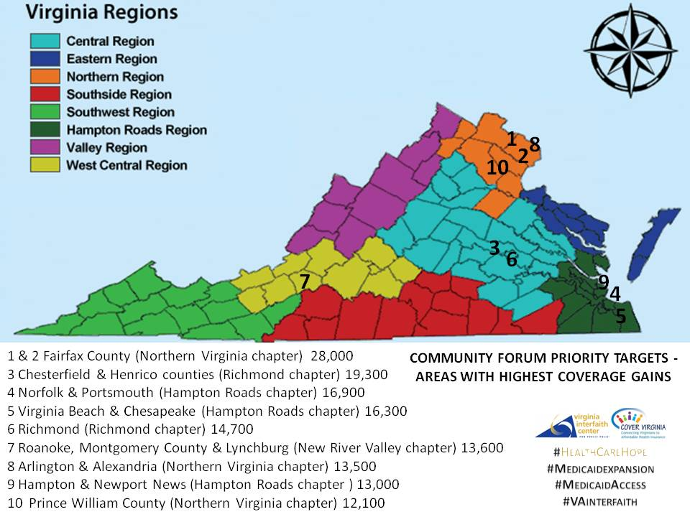
Outreach Priority Target 1

Slide 9
Outreach Priority Target 2
Targeted outreach to rural cities with the highest percentages of African Americans
Petersburg
Emporia
Franklin
Danville
South Boston
Martinsville
Suffolk
77%
64%
59%
49%
47%
46%
41%
Source: Housing Assistance Council
Source: US Census Data
#HealthCareHope
#Medicaidexpansion
#MedicaidAccess
#VAinterfaith

Slide 10
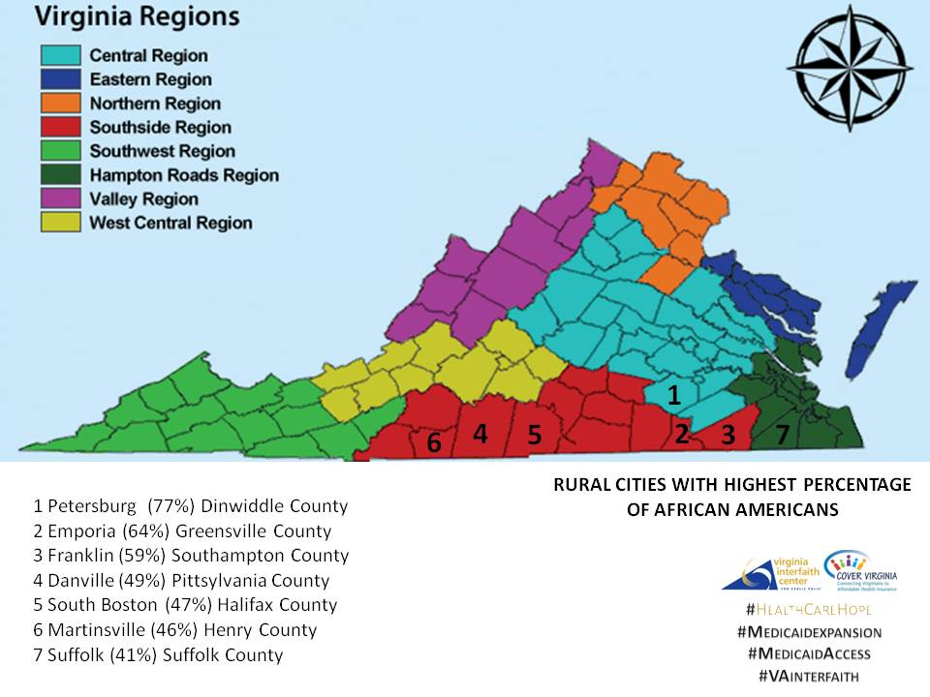
Outreach Priority Target 2

Slide 11
Outreach Priority Target 3
Targeted outreach to smallest rural towns <1,000 pop. with 50%+ African Americans
Lively
Greenbush
White Plains
Dendron
Bremo Bluff
Oldhams
Newtown
Branchville
Caret
Drewryville
Birdsnest
Cheriton
Withams
Warfield
Hustle
54 (50%)
532 (50%)
583 (53%)
966 (54%)
656 (57%)
107 (61%)
554 (62%)
497 (63%)
560 (64%)
787 (65%)
999 (68%)
148 (71%)
239 (71%)
610 (74%)
428 (79%)
Source: Housing Assistance Council
Source: US Census Data
#HealthCareHope
#Medicaidexpansion
#MedicaidAccess
#VAinterfaith

Slide 12
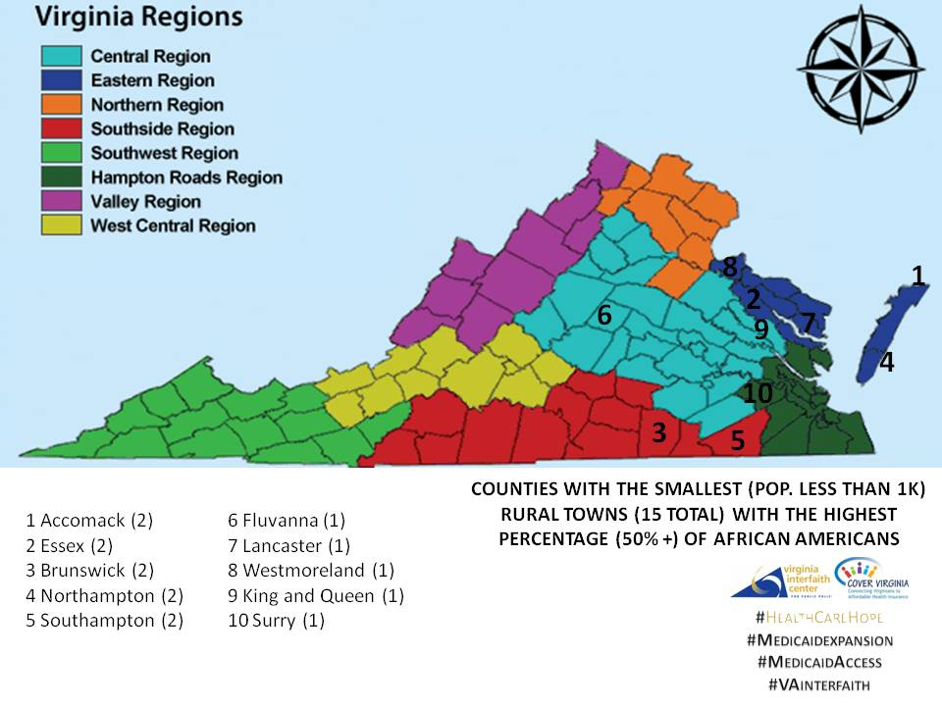
Outreach Priority Target 3

Slide 13
Timeline
#HealthCareHope
September/October: awareness and education
#ClosingTheGap
*Comment period on work requirements and cost-sharing closes mid-October
November/December: forums and outreach
#GetOutTheGap
*Media blitz to mark start of enrollment in November
January: video testimonials
#GotOutTheGap
February and Beyond: continued outreach
#HealthCareHope
#Medicaidexpansion
#MedicaidAccess
#VAinterfaith

